Slide 1
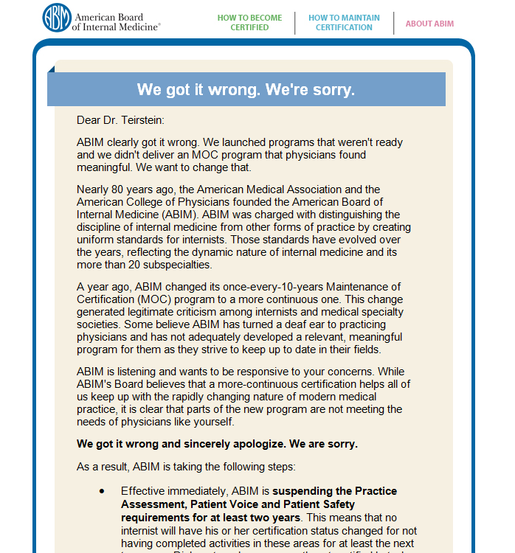
10 days after launching the NBPAS,
ABIM apologizes to hundreds of thousands of its diplomates

Slide 2
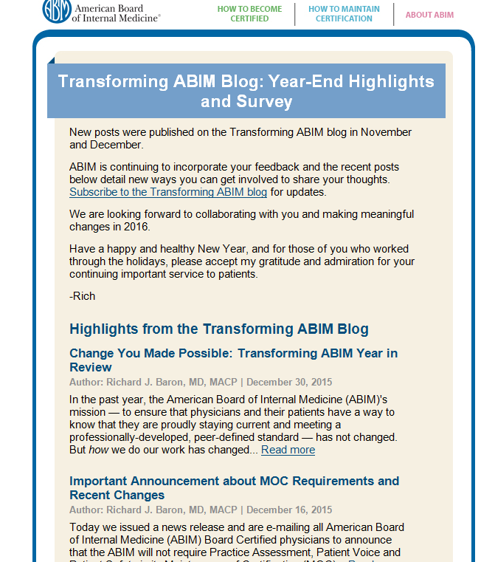

Slide 3
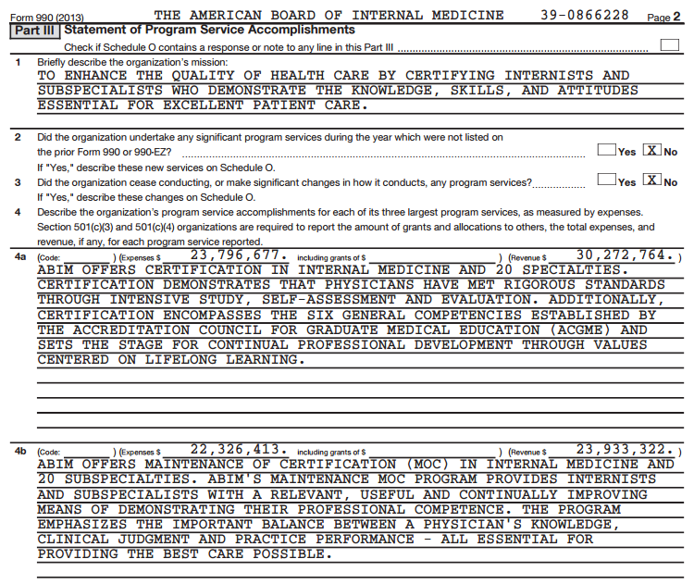

Slide 4
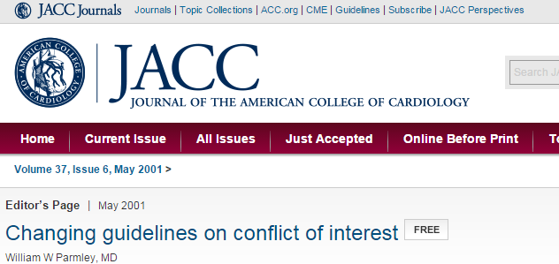
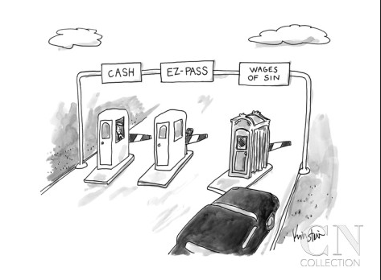
>200,000 x $200 = >$40M

Slide 5
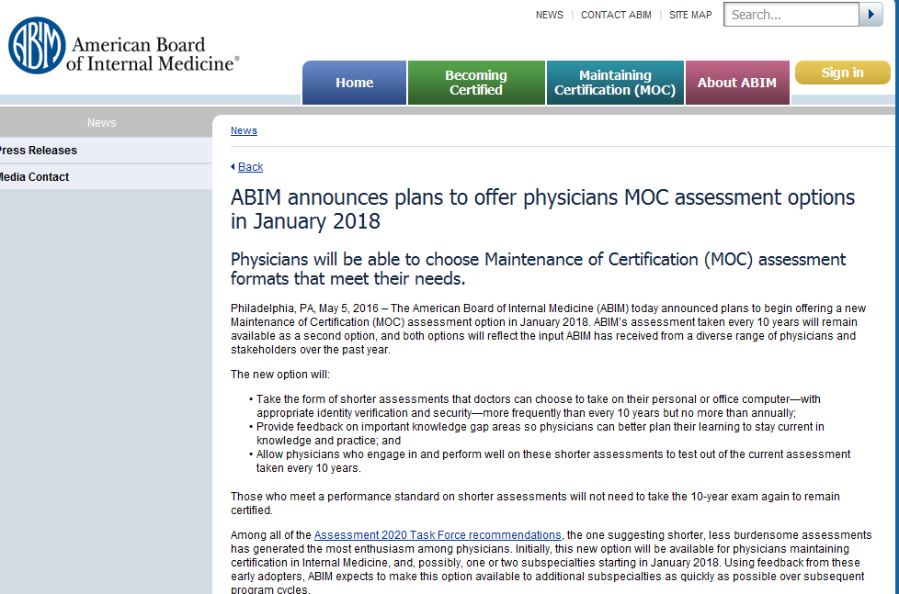

Slide 6
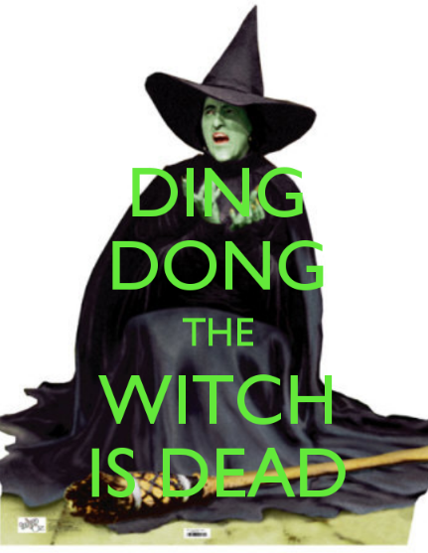
The end of the 10 year recertifying exam!

Slide 7
The end of the 10 year recertification exam…time to celebrate???
1) We have not yet heard details about the replacement for the 10 year recertification exam and how physician performance on the replacement will be assessed.
2) Will the replacement activity improve patient care? The replacement activity will surely be less onerous for the physician, but will it make a meaningful difference in patient outcomes? Ie, will it still be a waste of time and money?
3) Will the cost of certification MOC and recertification be reduced? By charging $200-$300 per diplomate annually for required MOC, ABIM collects $40-60M each year. Many physicians believe this is excessive and creates a conflict of interest for the ABIM. The ABIM is, indeed, transforming MOC. But, by requiring annual activities to fulfill MOC, ABIM is able to preserve its large annual revenue stream after its transformation.
4) This new option will not be initiated until 2018 and not be available in most specialties until even later. If ABIM believes the 10 year recertification exam should be replaced, shouldn’t there be a moratorium on this requirement until the replacement has been completed.

